Slide 1
Configuration Management
Configuration Management (CM) Standards Portfolio
DSP Conference 1-4 August 2022
Mr. Daniel K. Christensen
3 August 2022
NAVAIR Public Release SPR# 2022-460. Distribution Statement A - Approved for public release; Distribution is unlimited.
.

Slide 2

Non- Government Standards Background
The Department of Defense (DoD) published military standards (MIL-STD) to ensure defense contractors and suppliers employ consistent, efficient, and effective processes and conform to government policy. Secretary of Defense William Perry issued a memorandum in 1994 that prohibited the use of most military specifications and standards.
Section 12(d) of the National Technology Transfer and Advancement Act of 1996, Public Law (PL) 104-113, states Federal Agencies shall use technical standards developed or adopted by voluntary consensus standards bodies, unless impractical or inconsistent with law. Federal Agencies shall participate in development of voluntary consensus standards, unless incompatible with Agency mission, priorities, or resources.
NAVAIR Public Release SPR# 2022-460. Distribution Statement A - Approved for public release; Distribution is unlimited.

Slide 3
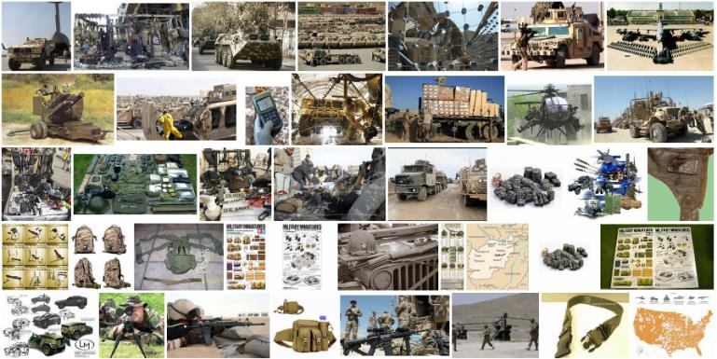
Non- Government Standards Background
During acquisition reform in the late 1990s and early 2000s, and in response to PL 104-113, the DoD cancelled many of the military standards and adopted commercial standards in their place as a cost-saving measure. For example, one of the first industry standards that the DoD adopted was the configuration management standard ANSI/EIA-649, “National Consensus Standard for Configuration Management,” then cancelled MIL-STD-973, Configuration Management (CM) in 2000.
NAVAIR Public Release SPR# 2022-460. Distribution Statement A - Approved for public release; Distribution is unlimited.

Slide 4
Complementary Coordinated Family of CM Principles and Processes
SAE EIA-649C “Configuration Management Standards”
This is an industry standard and is intended to be used when establishing, performing, or evaluating CM processes.
SAE EIA-649-1A “Configuration Management Requirements for Defense Contracts”
This is a defense unique standard to the non-government standard, that generates, manages and is controlled by the non-government standard body with Defense membership to provide requirements specific for Defense contracts. This standard is for placing tailored Configuration Management requirements on Defense contracts.
GEIA-HB-649A “Configuration Management Implementation Guide Handbook”
Initiated to synchronize content and harmonize terminology contained in both the GEIA-HB-649 and the MIL-HDBK-61A with its companion standard ANSI/EIA-649 by consolidating the two handbooks.
This handbook provides a one-stop shop for all CM professionals and practitioners to obtain recommended practice implementation guidance information that has actual use cases provided by Industry/Commercial and the Government/Department of Defense representing a cohesive and aligned community.
NAVAIR Public Release SPR# 2022-460. Distribution Statement A - Approved for public release; Distribution is unlimited.

Slide 5

Configuration Management Documentation
and Alignment
DoDD 5000.01 Enclosure 1
DoDI 5000.02 Enclosure 3
Policy
DAG
Chapter 4 (section 4.3.7)
Other Chapters: 2, 5, 7, 12, and 13
SAE
EIA-649C
Configuration Management Standards
MIL-HDBK-61B
Handbook
6 DD Forms
61 Request for Nomenclature (MIL-STD-196)
1692 Engineering Change Proposal (ECP)
1694 Request for Variance (RFV)
1695 Notice of Revision (NOR)
1696 Specification Change Notice (SCN)
2617 Engineering Release Record (ERR)
DD Forms
SAE EIA-649-1A
Configuration
Management
Requirements
for Defense Contracts
18 repetitive use DIDs ……Plus 31 Additional Associated DIDs
DI-SESS-80463 Engineering Release Record (ERR)
DI-SESS-80639 Engineering Change Proposal (ECP)
DI-SESS-80640 Request for Variance (RFV)
DI-SESS-80642 Notice of Revision (NOR)
DI-SESS-80643 Specification Change Notice (SCN)
DI-SESS-80858 Contractor’s Configuration Management Plan
DI-SESS-81022 Configuration Audit Summary
DI-SESS-81218 Product Baseline Index (PBLI)
DI-SESS-81121 Baseline Description Document
DI-SESS-81245 Installation Complete Notification (ICN)
DI-SESS-81248 Interface Control Document (ICD)
DI-SESS-81253 Configuration Status Accounting Information
DI-SESS-81646 Configuration Audit Plan
DI-SESS-81830 As Built Configuration List-Common (ABCL-C)
DI-SESS-81879 Configuration Item (CI) Documentation Recommendation
DI-SESS-81856 Contractual Baseline Report
DI-SESS-81011 Drawing/Model Number Assignment Report
DI-SESS-81254 Request for Nomenclature
CM DIDs
GEIA-HB-649A Implementation Guide for Configuration Management
IEEE 15288.1 and 15288.2
DAU Training
SE Standard
Technical Reviews and Audits Standard
SYS 101 CM Lesson
LOG 2040 CM
NAVAIR Public Release SPR# 2022-460. Distribution Statement A - Approved for public release; Distribution is unlimited.

Slide 6
Complementary Coordinated Family of CM Principles and Processes (cont.)
The acquirer must use a tailored SAE EIA-649-1A in concert with the SAE EIA-649C and leverage the guidance provided in associated handbooks, such as GEIA-HB-649A and MIL-HDBK-61B.
With this arsenal of collaborative and standardized CM requirements and guiding information, the CM professional should have a strategic advantage in implementing and executing acquirer/supplier (i.e., government/contractor) CM more efficiently and effectively.
NAVAIR Public Release SPR# 2022-460. Distribution Statement A - Approved for public release; Distribution is unlimited.

Slide 7
Additional Guidance
15288 IEEE Standard for Application of Systems Engineering on Defense Programs
This standard provides requirements for the application of ISO/IEC/IEEE 15288 for defense systems engineering needs.
15288.1 IEEE Standard for Application of Systems Engineering of Defense Programs
This standard implements ISO/IEC/IEEE 15288 for use by DoD organizations and other defense agencies in acquiring systems or systems engineering support. While primarily supporting the acquirer-supplier agreement mode, this standard also can be used to support the other modes: use by organizations, projects, and process assessors.
Available on ASSIST
15288.2 IEEE Standard for Technical Reviews and Audits on Defense Programs
This standard is intended to elaborate the technical review and audit clause of ISO/IEC/IEEE 15288, System life-cycle processes, for use by the DoD and other defense agencies in acquiring systems (and parts thereof) or services.
Available on ASSIST
NAVAIR Public Release SPR# 2022-460. Distribution Statement A - Approved for public release; Distribution is unlimited.

Slide 8

Questions?
NAVAIR Public Release SPR# 2022-460. Distribution Statement A - Approved for public release; Distribution is unlimited.

